Slide 1




TRANSFORMING BURKINA FASO INTO A CENTER OF AGRICULTURAL AND MINING PRODUCTION AND PROCESSING

Slide 2
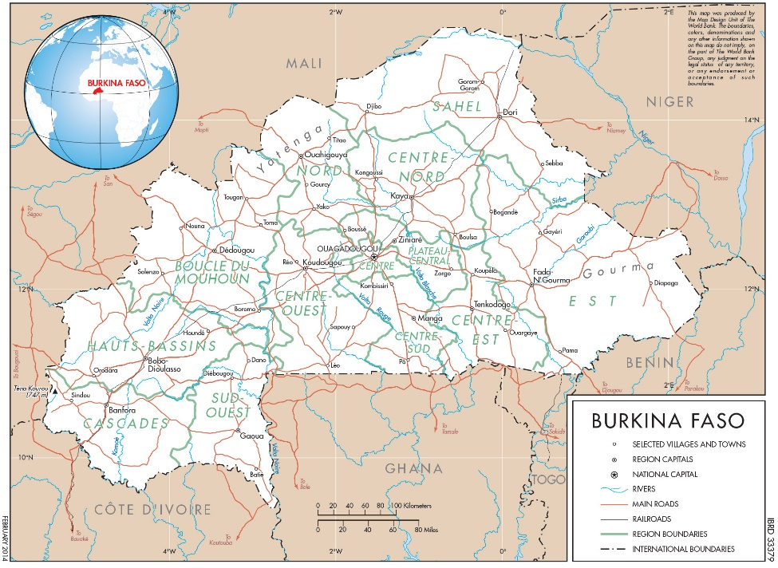
Country Context
POLITICAL AND INSTITUTIONAL STABILITY in spite of a difficult security situation
SOUND MACROECONOMIC MANAGEMENT
Average GDP growth of 6% p.a. since 2000 and expected to continue;
Budget deficit typically about 3% of GDP (3.9% on average during 2014-17);
Debt-to-GDP : 41% and not forecast to increase;
Low inflation (2 % in 2017);
Fixed exchange rate between CFA franc and the Euro;
Credit rating of B/B Stable Outlook (Standard & Poor’s).
CONTINUOUS IMPROVEMENT IN THE INVESTMENT CLIMATE
2nd best country in West Africa on the Corruption Perception Index;
A strong legal and institutional framework for Doing Business indicators;
An investment promotion agency, commercial courts, an Arbitration and Mediation Center, and a Credit Bureau;
A modern tax system which meets budgetary needs while promoting private investment.
KEY FACTS
Official Language | French
Currency | XOF
Area | 274 200 km2
Population | 19 632 147, F (52%); M (48%)
Literacy Rate | 86%
GDP | US$ 13.3 billion
GDP growth rate (2017) | 6.4%
GDP per capita | US$ 636
Main Exports | Gold, Cotton, Livestock/Meat, Sesame

Slide 3
ACTIONS TO BE TAKEN TO TRANSFORM BURKINA FASO INTO A CENTER OF AGRICULTURAL AND MINING PRODUCTION AND PROCESSING
MAINTAIN STRONG MACROECONOMIC FRAMEWORK
Implement new 2018-2020 ECF program supported by the IMF;
Elaborate a new debt management strategy favoring concessional borrowing;
Conduct cost-benefit analysis of all large projects including Public-Private Partnerships;
Create fiscal space for priority public investments through increased domestic revenue mobilization and contained current spending.
FURTHER STRENGTHEN ECONOMIC GOVERNANCE
Reform the legal and institutional framework for public procurement;
Adopt the implementation texts for the law for the fight against corruption;
Computerize the documentation required for public expenditures;
Create a general inspection unit for the civil service to manage the wage bill;
Adopt a new policy for decentralization and de-concentration;
Adopt a new law for land management.
INCREASE DOMESTIC RESOURCE MOBILIZATION
Expand the use of a standard form for all taxpayers to reduce fraud and protect VAT collection;
Put in place on-line procedures for the declaration and payment of taxes ;
Computerize the system of fiscal controls and use risk-based selection methods ;
Expand GPS tracking for transit merchandise and connect with customs of Côte d’Ivoire and Togo.

Slide 4
ACTIONS TO BE TAKEN TO TRANSFORM BURKINA FASO INTO A CENTER OF AGRICULTURAL AND MINING PRODUCTION AND PROCESSING
IMPROVE THE INVESTMENT CLIMATE
Revise legal/regulatory framework on contract enforcement, access to land, protecting investor rights, and connecting to electricity;
Reduce the time and cost to create a business, to obtain a construction permit and to get a land title;
Adopt a new labor code which further liberalizes the labor market ;
Put in place a single window for investors and create an on-line guide on all administrative procedures;
Accelerate the use of on-line processes to facilitate administrative procedures;
Adopt the implementation texts of the new mining code.
ENHANCE SECURITY FOR DEVELOPMENT
Fight terrorism by improving the socio-economic conditions of the population living in the Sahel region of the country which is the most exposed to attacks and radicalization ;
Operationalize a unit for the fight against terrorism;
Reinforce the implementation of the Emergency Programme for the Sahel
DIVERSIFY SOURCES OF FINANCING
Revise the legal and regulatory framework to promote Public-Private Partnerships;
Establish specialized bank for SMEs;
Strengthen/diversify financing instruments for agriculture (partial credit guarantees, medium/long-term lines of credit, insurance);
Strengthen the capacity of the banking sector to support agribusiness value chains;
Promote digital finance, including certification through e-signatures;
Channel savings of the diaspora into productive investments.

Slide 5
INVESTMENT OPPORTUNITIES
AN ESTABLISHED TRACK RECORD
Largest exporter of cotton and sesame in Africa;
Major exporter of livestock (130,000 tons per year);
Third largest exporter of gold in west Africa;
Reserves of manganese, zinc, copper, bauxite, phosphate, limestone;
Rapid expansion of ICT: three mobile operators and 1.5 million internet users;
Access to the ocean via a rail link to Abidjan;
Good potential for regional trade given its central location with 6 neighbours;
  Member of ECOWAS with access to market of $675 billion;
  Headquarters of the West Africa Economic and Monetary Union.

Slide 6
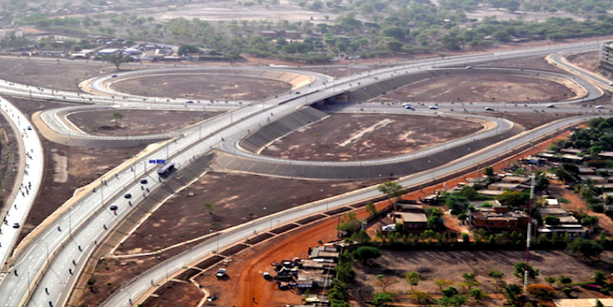

INVESTMENT OPPORTUNITIES
MINING
→ Under-exploited reserves and a mining code among the most attractive in Africa.
Development of the mining sector is recent (2008) but its growth has been spectacular (46 tons in 2017);
In addition to the 11 mines in operation and others under construction, there are unexploited reserves of manganese, zinc, copper, limestone, phosphates, and bauxite;
Member of EITI since 2008
TRANSPORTATION
→ Attractive space for greater private sector participation in the transport sector
Construction of the rail link between Tambao (manganese reserves) and Ouagadougou via Kaya and Dori ;
Construction and management of a new international airport at Ouagadougou-Donsin ;
Creation of a dry port in Ouagadougou;
Management concession for the services at all international airports in the country.

Slide 7
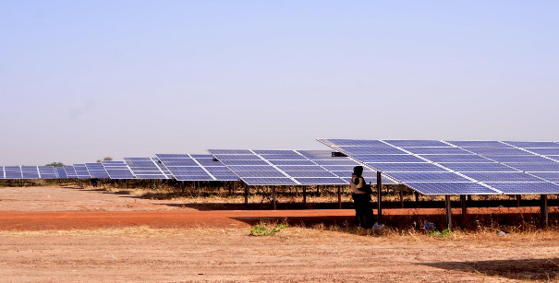
INVESTMENT OPPORTUNITIES
ENERGY
→ Solar power resources with radiation of 5.5 KwH per square meter and per day in the context of total liberalization of the power generation sub-sector;
→ Need to diversify the energy mix while expanding regional interconnections
Construction and exploitation of large-scale power plants (notably solar and thermal);
Creation of assembly units for photovoltaic modules;
Construction of oil pipeline between Ferkessédougou (Côte d'Ivoire) and Ouagadougou.
THE ZAGTOULI SOLAR POWER PLANT
Construction of a solar power plant of 33 MWc at Zagtouli was the first experience with diversifying the sources of electricity generation in Burkina Faso;
The extension project will increase production by 22.5 MWc while improving the national energy mix.

Slide 8
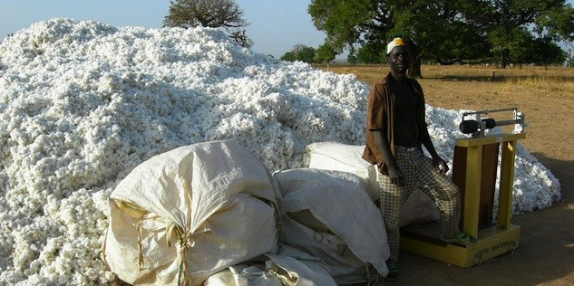
INVESTMENT OPPORTUNITIES
AGRO-INDUSTRY
A leader in the production of cotton, sesame, and meat; good potential in fruit and vegetables;
Presence of specialized institutions;
Transformation of cotton (spinning, textiles, clothing), agricultural marketing, and the existence of special economic zones offer attractive investment opportunities.
Creation of industrial units for the manufacture and assembly of agricultural equipment (tractors, power tillers), and the transformation of agricultural products and bi-products;
Installation and operation of modern factories for the meat, milk, and other livestock products.
Two agropoles already being implemented in Sourou and Samendéni, in addition to the one at Bagré (Bagrépole) to increase and diversify agricultural production and improve food security for the local population ;
Development of two special economic zones at Ouagadougou and Bobo-Dioulasso ;

Slide 9
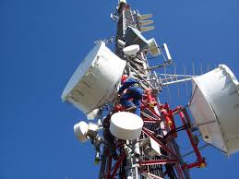
INVESTMENT OPPORTUNITIES
INFORMATION AND COMMUNICATION TECHNOLOGY
→ 85% of the population own a mobile phone but only a few have access to high-speed internet; the network needs improvement and computer skills need to be developed (2017)
Expansion of fiber optic network and cell phone towers;
Creation of a virtual university and establishment of 13 digital centers in the regions ;
Establishment of technopoles and incubators ( over xx year)
  7 university technopoles ;
  3 technopoles for pharmaceuticals, agri-business, and energy;
  One ICT technopole at Ouagadougou;
Development of e-health and e-agriculture;
Development of mobile banking.

Slide 10
PARTNER SUPPORT
MACROECONOMIC
Increased and improved predictability of budget support in a less favorable security environment;
Assistance for implementing a strategy for selection and rationalization of investments with a greater role for the private sector;
Support for the implementation of structural reforms.
INVESTMENT CLIMATE
Assistance for the elaboration of a strategy to transform Burkina Faso into a center of agricultural and mining production and processing;
Preparation of a project to improve the investment climate with the support of partners;
Design a project to address skills mismatch through trainings and increase skilled workforce.
FINANCING
Mobilisation of private investment through PPPs and foreign direct investment in priority sectors ;
Support to increase domestic resource mobilization and financial inclusion;
Access to mechanisms for risk management, such as partial risk guarantees;
Access to new financing facilities from IFIs;
Funds for feasibility studies to facilitate decision-making by investors.
MAIN PARTNERS
IFIs (IMF, WBG, AfDB), EU, and bilaterals.

Slide 11
Contact
Direction Générale de la Coopération (DGCOOP)
03 Box 7067 Ouagadougou 03
Phone : 226 25-30-89-92 or 226 25-33-30-17
Web site of DGCOOP: www.dgcoop.gov.bf
Web site for PNDES : www.pndes2020.com

