Slide 1
Notes:
My second question is: What is winning national digital strategy for LICs or any country for the future?
Today--given that technologies are transforming the world and impact the way we live, love, work, learn and the way we pay for everything—national strategies must embrace the new reality: digitization, also known as the “4th industrial revolution” with winning digital strategies.
However, countries like mine, may cannot always conduct public sector R&D to fully understand the impact of the 4th Industrial revolution.
Indeed, most LICs don’t always have the resources, or the knowledge, or the human capital, or even the infrastructure to develop and adopt impactful digital strategies that maximize technology benefits and reduce/eliminate risks.
Nonetheless, LICs, now need to build on the successes of previous policies to ensure that the current and future generations have the education and skills they need for the fourth industrial revolution and “fit for future” industries. As Emre’s presentation and paper demonstrate, SSA will need 20 million jobs for the projected 20 million youths.

Slide 2








Notes:
I grew up in Zambia, in a family, where generations benefited from a strong “concerted” Government policy that prioritized education as a strategic goal for the country. After independence from British rule, the first republic understood the importance of ensuring that its citizen were educated and equipped for work in the then second industrial revolution and the third industrial revolution. The policies included free quality education for all and equal education for both men and women.
As a matter of fact, the women in my family have seen firsthand the difference an integrated and well executed national education strategy changed our life trajectory. My grandmother was able to go back to school after having 12 children. My mother, who studied accounting, and 5 of her sisters graduated too and then me, my siblings, and our cousins.
The pictures you see up there are third and fourth generations family members.

Slide 3
Notes:
My second question is: What is winning national digital strategy for LICs or any country for the future?
Today--given that technologies are transforming the world and impact the way we live, love, work, learn and the way we pay for everything—national strategies must embrace the new reality: digitization, also known as the “4th industrial revolution” with winning digital strategies.
However, countries like mine, may cannot always conduct public sector R&D to fully understand the impact of the 4th Industrial revolution.
Indeed, most LICs don’t always have the resources, or the knowledge, or the human capital, or even the infrastructure to develop and adopt impactful digital strategies that maximize technology benefits and reduce/eliminate risks.
Nonetheless, LICs, now need to build on the successes of previous policies to ensure that the current and future generations have the education and skills they need for the fourth industrial revolution and “fit for future” industries. As Emre’s presentation and paper demonstrate, SSA will need 20 million jobs for the projected 20 million youths.

Slide 4

Understand Disruptive Technologies
Measure Digital Connectivity
Consider
4 Digital Building Blocks
Notes:
Specifically, we work on three elements.
The first element is that we study the top 6 technologies that are impactful on the digital economy.
The second element is that we have developed a framework of four Digital Building Blocks that can help countries boost their digital strategies and understand the impact of the top 6 technologies.
The third element is that we measure global digital connectivity and provide evidence from sub-Saharan Africa on drivers, cost and mobile digital divide.

Slide 5
Understand Disruptive Technologies
Consider
4 Digital Building Blocks
Measure Digital Connectivity
Notes:
Specifically, we work on three elements.
The first element is that we study the top 6 technologies that are impactful on the digital economy.
The second element is that we have developed a framework of four Digital Building Blocks that can help countries boost their digital strategies and understand the impact of the top 6 technologies.
The third element is that we measure global digital connectivity and provide evidence from sub-Saharan Africa on drivers, cost and mobile digital divide.

Slide 6
Blockchain
Data Processing
AI / ML
Robotics, Automation
Digital Platforms
IoT
(Internet of Things)
Notes:
As mentioned earlier, for the first element of our work, we study the top six transformative technologies: Blockchain, Data processing (which includes Big Data), Robots/Automation, and the IoT.
We have a use cases on how they can be applied to help countries understand the risks, benefits and trends of these technologies.

Slide 7
Understand Disruptive Technologies
Consider
4 Digital Building Blocks
Measure Digital Connectivity
Notes:
The second element is that we have developed a framework of four Digital Building Blocks that can help countries boost their digital strategies.
The building blocks include: Citizen Centric eGovernment, Goal-oriented innovation, Managing Digital Risks, and Digital Inclusion.
Given the scale, complexity and pace of technology, the building blocks are important as they provide governments with a standardized framework to understand the impact of the top 6 technologies, implement, and adopt them for inclusive growth, while minimizing risk.
Overall, the good news is that most governments, in all regions, have national digitization strategies in place.
Our research on what successful countries are doing, shows that good digital strategies in one form or another encompasses these 4 “Digital Building Blocks”
[click to get the 4 blocks displayed, then immediately move on to the next slide]

Slide 8




Citizen-Centric eGovernment
Notes:
The first digital building block relates to digitalization of the government services for citizens, such as revenue and tax collection, or digital moneys such as Central Bank Digital Currencies.
Citizen-centric eGovernment is important given that achieving a national digital strategy, starts with governments digitizing themselves. But we are finding that this is easier said than done. How do you design financial services for the hard-to-reach population, hard-to-reach economically, physically, culturally? What are the foundational requirements to enable a citizen-centric government?
eGovernment is important for better service delivery to citizens, and eventually engagement with citizens through online feedback mechanisms.
Our research shows some typical challenges in eGovernment services:
Working in silos and lack of coordination. Most government agencies and central banks are developing their digital strategies in silos. There is often little coordination across ministries, let alone with the central bank. More efficiency can be gained with better coordination, collaboration, and alignment with the overall National Digital Strategy.
Design challenges. We mentioned “Citizen-centric” service. This is a design issue that is not well understood. Winning strategies put the citizen (not the product or service!) at the center of the eGovernment design.
Need for Digital identifies. We have also observed that in many cases, such digitization efforts are hampered by the lack of digital identity (in some countries, they lack identity documents altogether!). India with their Addhaar digital identity has led the way in unlocking and simplifying access to government digital services.
IMF Work on the building block.
In our work at the IMF, we work for example with countries on how digitization impacts revenue collection. As you know we also work a lot on digital currencies, and I invite you to look at our web site for some important papers on that topic.

Slide 9

Citizen-Centric eGovernment
Goal-Oriented Innovation
Notes:
The second building block calls for goal-oriented innovation, especially for countries for countries with low resources.
As technologists, we see the enormous value of innovation to a technology perspective. But it’s also about economic impact, as president Kagame said at the 2017 Davos meeting, it is the governments role to understand how innovation will impact the nation and be implemented.
LIC don’t always have the R&D or other resources, so it is imperative to set specific goals to their innovation initiatives. Possibly even bold goals. The goals should also aim to foster industries of the future, reskilling, and job creation--as Emre will talk about.
Our study shows that most countries have some sort of innovation hub or regulatory sandbox.
However, not many countries have set specific, bold goals to maximize the value of their limited resources.
Many low-income countries do not always have access or the ability to leverage the most recent technology and digital information, so they need to set innovation hubs that allows them to stay on top of the most recent research on things like open data, open banking, or flexible regulation.
For this BB, we use our own iLab, which you can visit on the 2nd floor, to understand innovation ourselves. For example, we have created with the WBG our own blockchain crypto-asset, which we called Learning Coin, which is a lab tool to understand blockchain. We will make the source code available soon to central banks.

Slide 10


Citizen-Centric eGovernment
Goal-Oriented Innovation
Risk Management:
Cyber Security
Data Privacy
News Authenticity
Notes:
The third building block facilitates the discussion on planning, and managing digital risks. Successful strategies must establish a rigorous approach to risk management.
The more a country relies on technology, the more technology risks and disruption can adversely impact economic growth, financial stability and/or integrity. Governments must recognize their increased responsibility to manage digital risks.
Our research shows: Major risks include cyber security of course, but also data privacy and ethical concerns, system failures due to network issues/ electricity outages. Specifically
Security measures in developing countries are not always as robust as in other parts of the world, which makes them attractive target. You’ve all heard about the major cyber-attacks in 2016 on the central banks of Bangladesh, Ecuador, Philippines and Vietnam.
Data privacy is another growing digital concern. Countries are looking at how Europe, with their General Data Privacy Regulations (GDPR) directive, is trying to protect citizens data, and we observe a lot of activity in that domain.
System failures, as more services and products are digitized, countries will need to understand the significance of business continuity. Countries need to plan and prepare for potential disruption when the system goes down due to electricity outages or cyber-attacks for example.
IMF Work on the building block.
In our work with Central Banks, we are often asked to provide Cyber Security Technical Assistance, which countries find tremendously valuable. There is definitely a need to share more knowledge across countries.

Slide 11

Citizen-Centric eGovernment
Goal-Oriented Innovation
Risk Management:
Cyber Security
Data Privacy
News Authenticity
Digital Inclusion
Notes:
Finally, national digital strategies should also leverage the 4th building block, which deals with Digital Inclusion. Specifically, we analyze Infrastructure (physical, IT, and Human Capital infrastructures) and the implementation and adoption of technology.
I will now let Emre explain some of the research that African Department has done, in relation with this Building Block, and some of the conclusions they have drawn.

Slide 12
Understand Disruptive Technologies
Consider
4 Digital Building Blocks
Measure Digital Connectivity
Notes:
Transition to Emre.
I will leave it to Emre to discuss the third element we work on, through research they have done in the African Department, on how countries can better assess their access to digital services.

Slide 14


Slide 16
Enhanced Digital Access Index (EDAI)
Internet usage
Quality
Knowledge
Affordability
Infrastructure
Challenges
Macro Policies

Slide 18
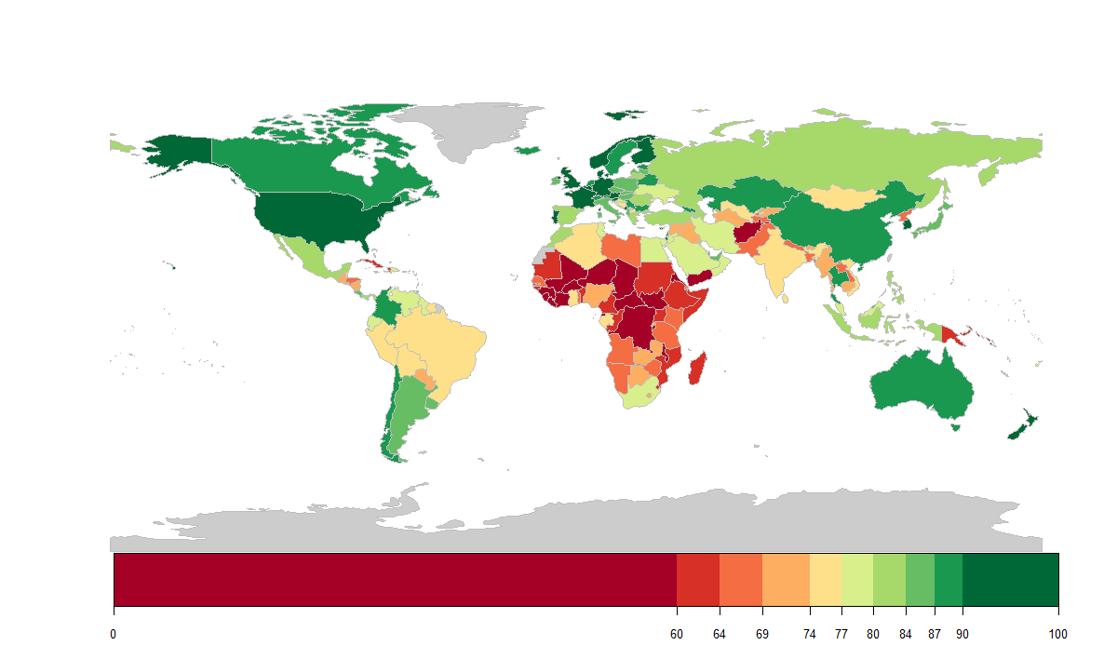
Significant heterogeneity in global digital connectivity
Sources: ITU’s ICT Indicators database, UN’s E-Government Survey, UNESCO’s UIS and staff calculations.
Challenges
Macro Policies

Slide 20
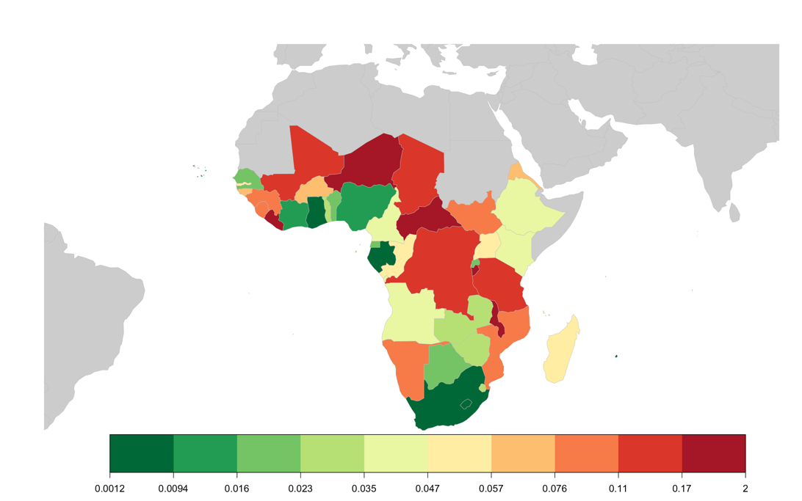
Annual Cost of Full-scaled 4G Network in 2025
(as percentage of GDP)

Slide 22


